Slide 1
Course Code: CSC211A Course Title: Formal Languages and Automata Theory
Session 23: Non-Context Free Language
Course Leader:
Prakash P
prakashp.cs.et@msruas.ac.in

Slide 2
Session Objectives
At the end of this session, student will be able
Explain non-context free language
Describe deterministic PDAs
Understand positive properties of context-free languages

Slide 3
Session Topics
Non-Context Free Language
Deterministic PDAs
Positive Properties of Context-Free languages

Slide 4
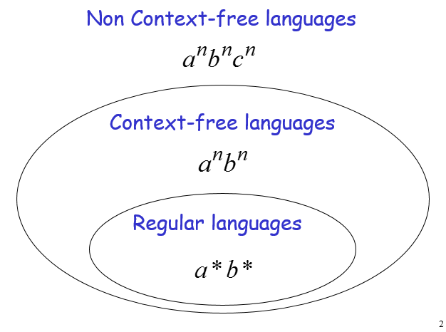
Non-Context Free Language

Slide 5
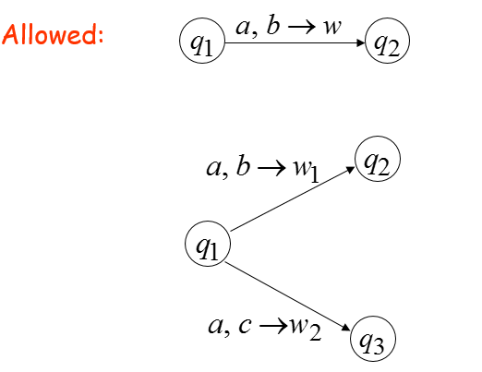
Deterministic PDAs

Slide 6
Deterministic PDAs
Not allowed:

Slide 7
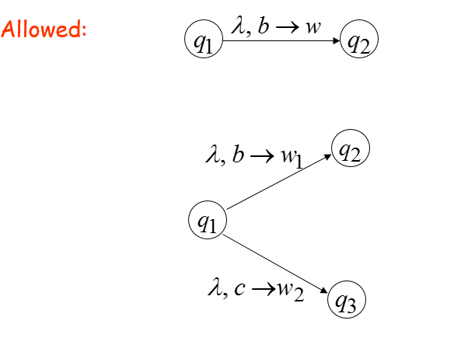
Deterministic PDAs
Something must be matched from the stack

Slide 8
Deterministic PDAs
Not allowed:

Slide 9
DPDA Example

Slide 10
DPDA
The language
is deterministic context-free
Definition:
A language is deterministic context-free if some DPDA accepts it

Slide 11
Example of Non-DPDA (NPDA)

Slide 12
Example of Non-DPDA (NPDA)
Not allowed in DPDAs

Slide 13
NPDAs Have More Power than DPDAs

Slide 14
NPDA and DPDA
We will show:
there is a context-free language
(accepted by a NPDA)
which is not deterministic context-free
(not accepted by a DPDA)

Slide 15
NPDA and DPDA
The language is:

Slide 16
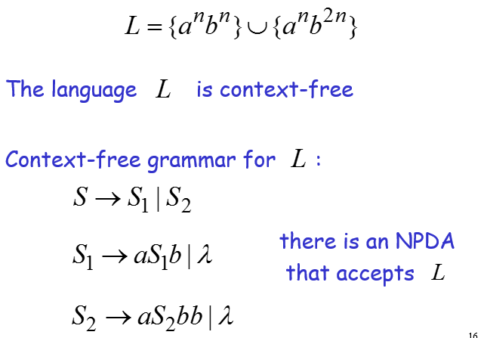
NPDA and DPDA

Slide 17
NPDA and DPDA
Theorem:
The language
is not deterministic context-free
(there is no DPDA that accepts )

Slide 18
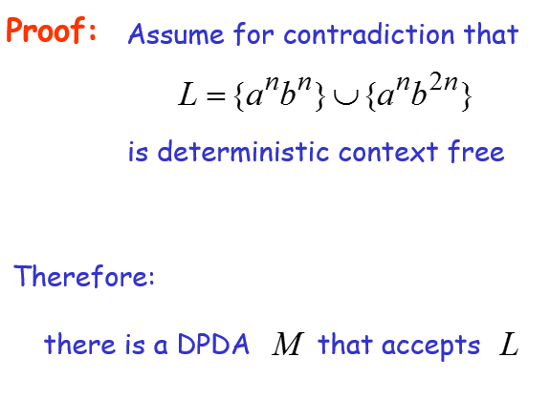
NPDA and DPDA

Slide 19
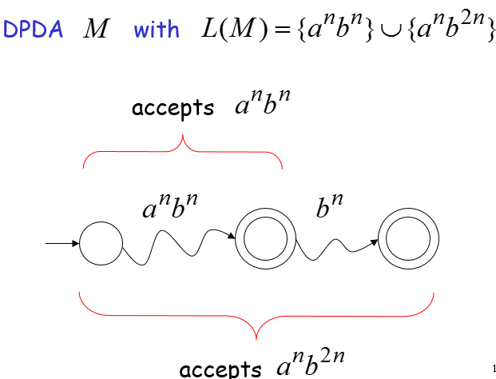
NPDA and DPDA

Slide 20
NPDA and DPDA
Fact 1:
The language is not context-free

Slide 21
NPDA and DPDA
Fact 2:
The language is not context-free
(a consequence of Fact 1)

Slide 22
NPDA and DPDA
We will construct a NPDA that accepts:
Contradiction!

Slide 23
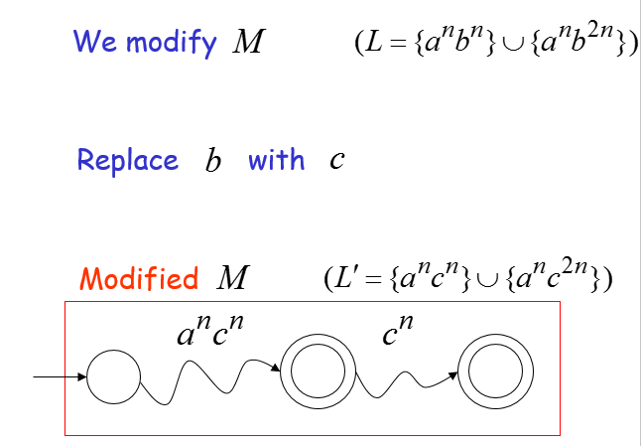
NPDA and DPDA

Slide 24
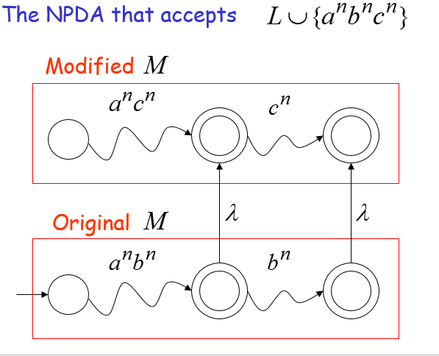
NPDA and DPDA

Slide 25
NPDA and DPDA
Since is accepted by a NPDA
it is context-free
Contradiction!
(since is not context-free)

Slide 26
NPDA and DPDA
Therefore:
There is no DPDA that accepts
Not deterministic context free
End of Proof

Slide 27
Positive Properties of Context-Free languages

Slide 28
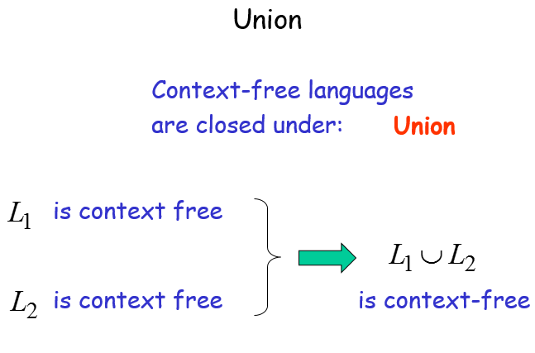
Union

Slide 29
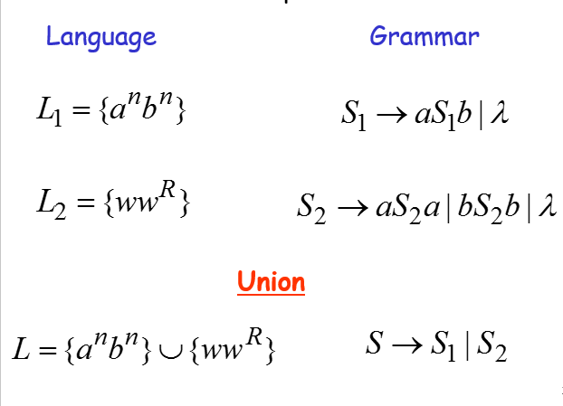
Example

Slide 30
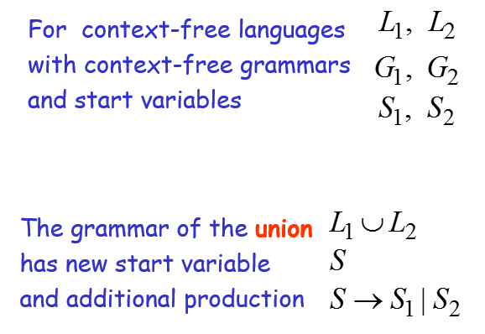
In General

Slide 31
Concatenation
Context-free languages are closed under:
Concatenation
is context free
is context free
is context-free

Slide 32
Example
Language
Grammar
Concatenation

Slide 33
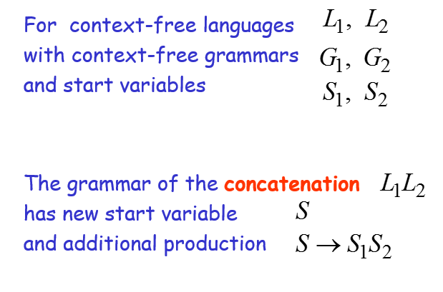
In general

Slide 34
Star Operation
Context-free languages are closed under:
Star-operation
is context free
is context-free

Slide 35
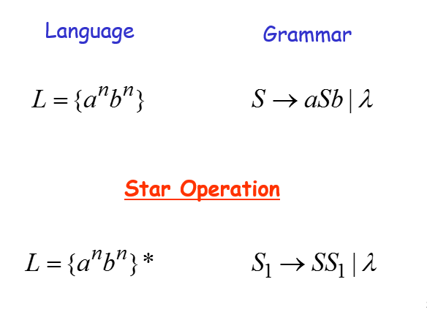
Example

Slide 36
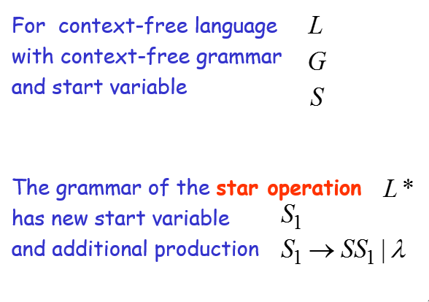
In General

Slide 37
Summary
A language is deterministic context-free if some DPDA accepts it.
NPDAs have more power than DPDAs.
Context-free languages are closed under concatenation and star operation.

